Slide 1

Data Description
Session 8
M. Kachour

Slide 2
The Form indicators
A numerical indicator is called of the form if it is a key number to characterize the distribution around a central value, such as the average data, relative frequencies (or frequencies) associated with observations / modalities.
In this course, we will focus on asymmetry coefficients
Explicitly, we will study the following indicators:
The Pearson coefficient
The Yule and Kendall coefficient
Indicators associated with data from a quantitative variable only

Slide 3
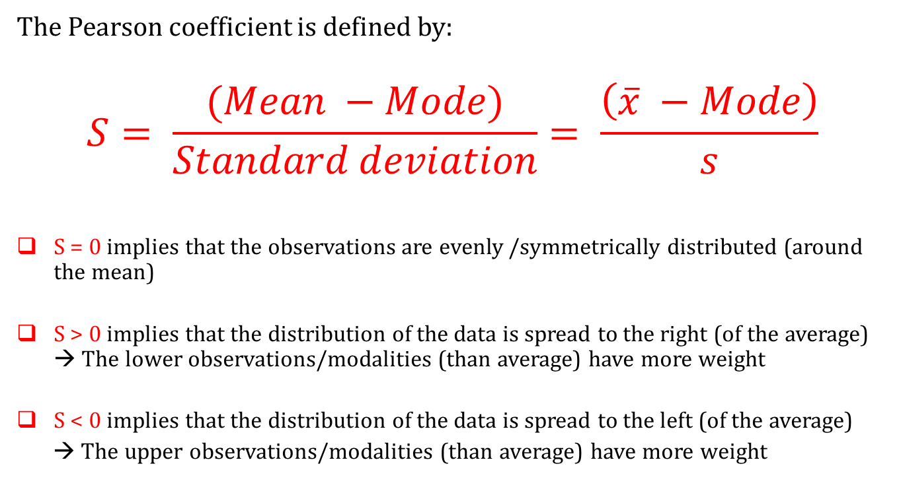
Asymmetry Indicators –
The Pearson Coefficient
The Pearson coefficient is defined by:
$$S= \frac{(Mean −Mode)}{Standard deviation}= \frac{\left(\overline{x} −Mode\right)}{s}$$
S = 0 implies that the observations are evenly /symmetrically distributed (around the mean)
S > 0 implies that the distribution of the data is spread to the right (of the average) → The lower observations/modalities (than average) have more weight
S < 0 implies that the distribution of the data is spread to the left (of the average)
→ The upper observations/modalities (than average) have more weight

Slide 4
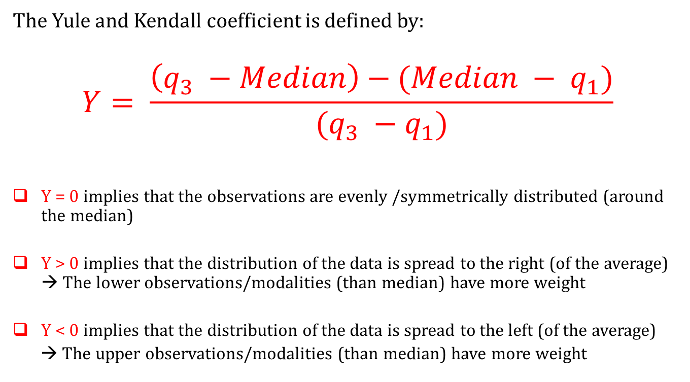
Indicators of asymmetry –
The Yule and Kendall coefficient
The Yule and Kendall coefficient is defined by:
$$Y= \frac{\left(q_{3} −Median\right)−(Median − q_{1})}{(q_{3} −q_{1})}$$
Y = 0 implies that the observations are evenly /symmetrically distributed (around the median)
Y > 0 implies that the distribution of the data is spread to the right (of the average) → The lower observations/modalities (than median) have more weight
Y < 0 implies that the distribution of the data is spread to the left (of the average)
→ The upper observations/modalities (than median) have more weight

Slide 5
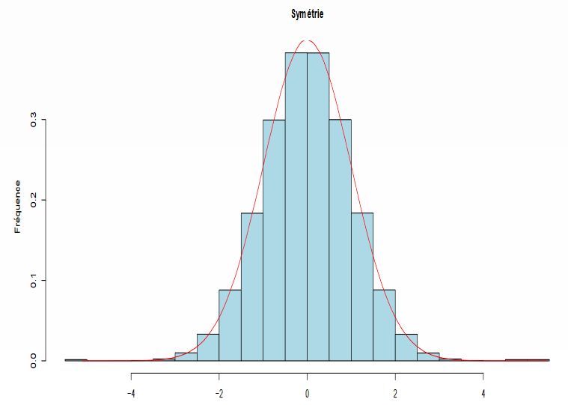
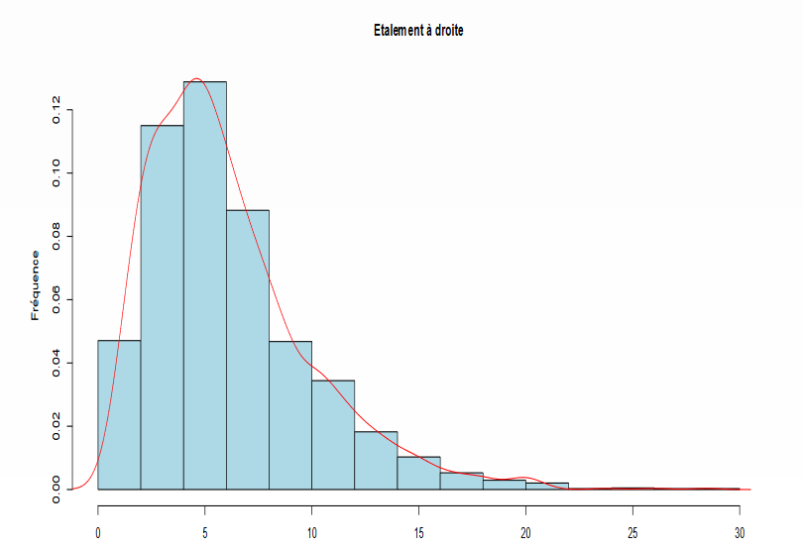
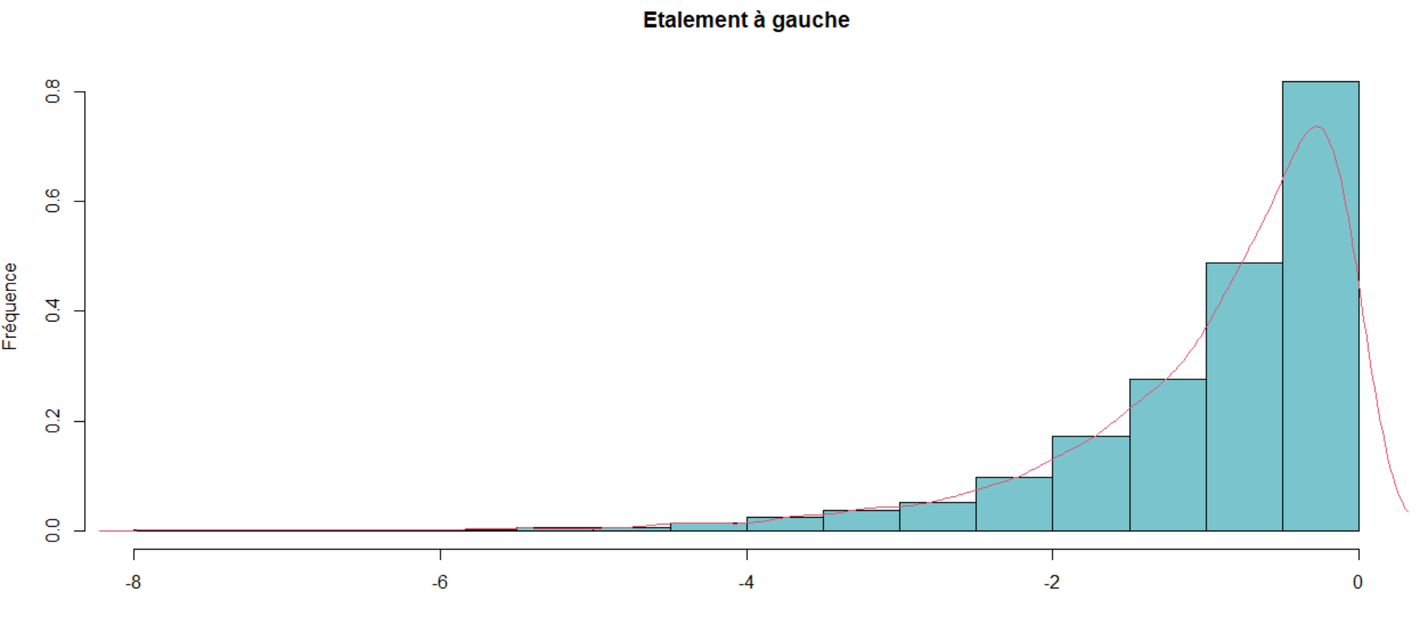
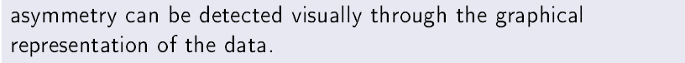
Asymmetry - Graphically
Spread on the right
symmetrically distributed
Spread on the left

Slide 6
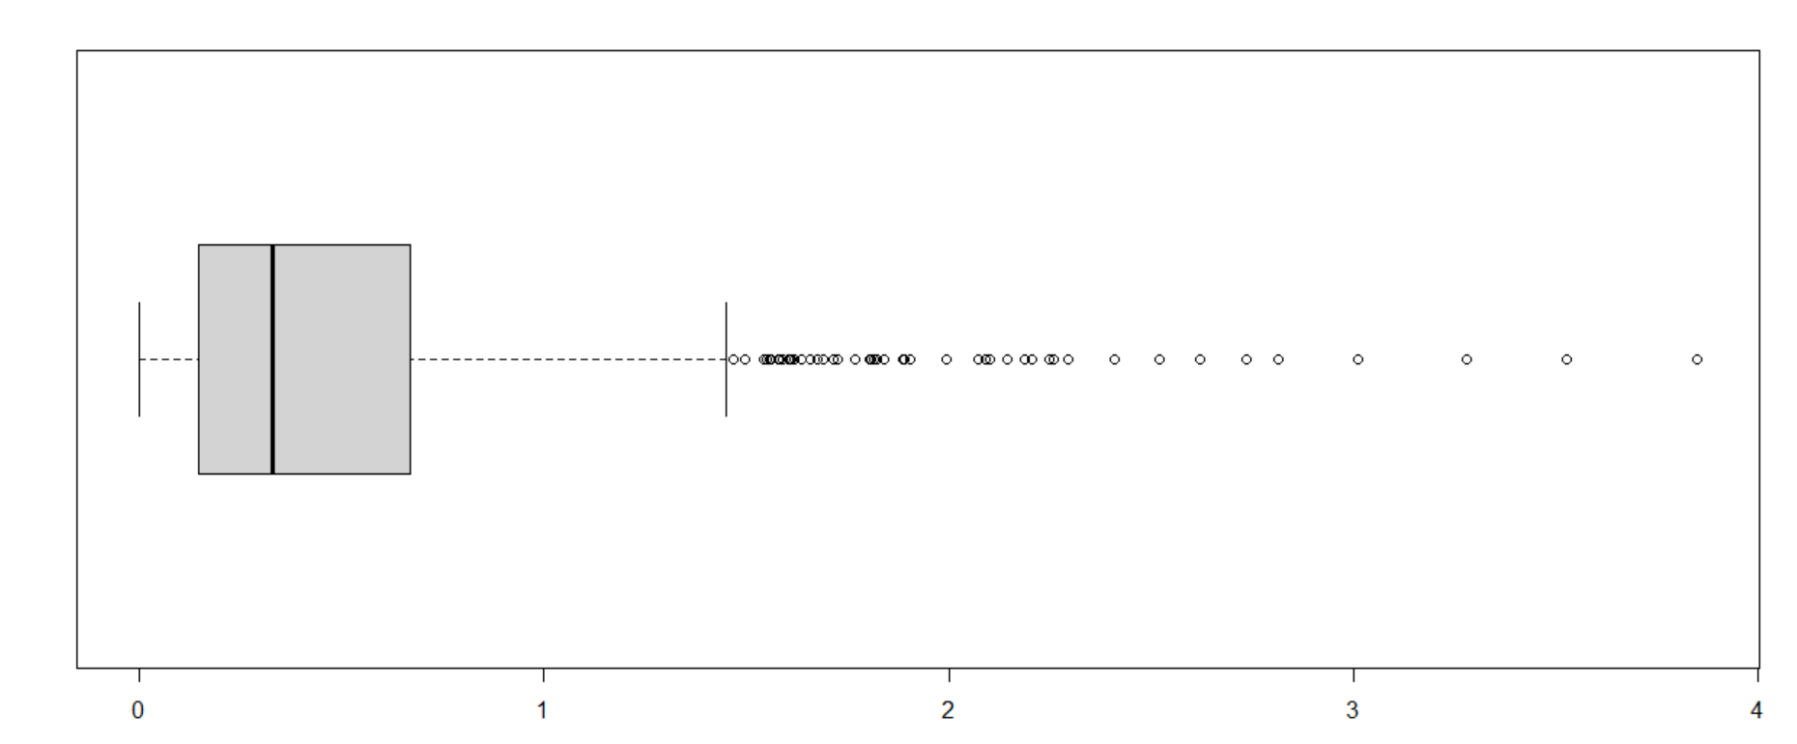
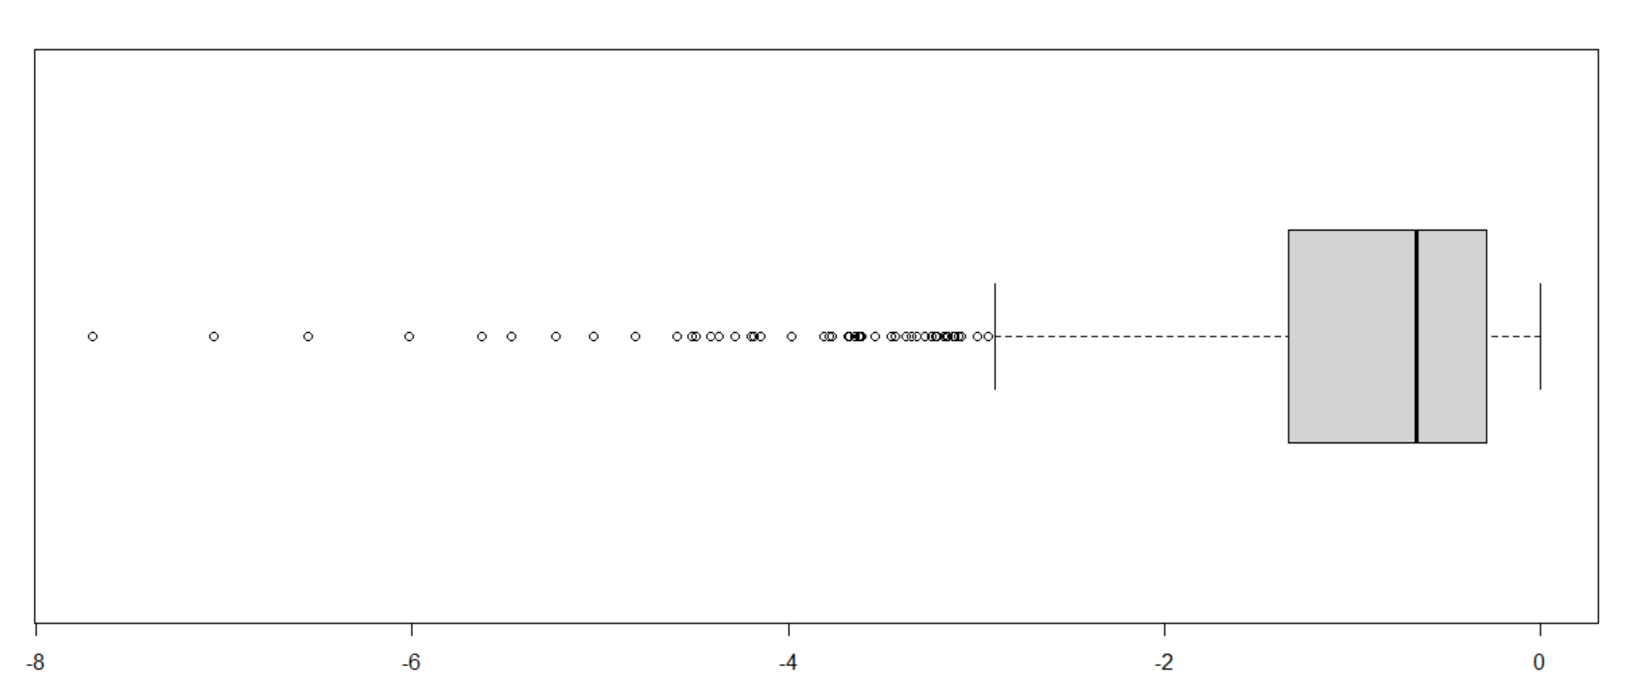
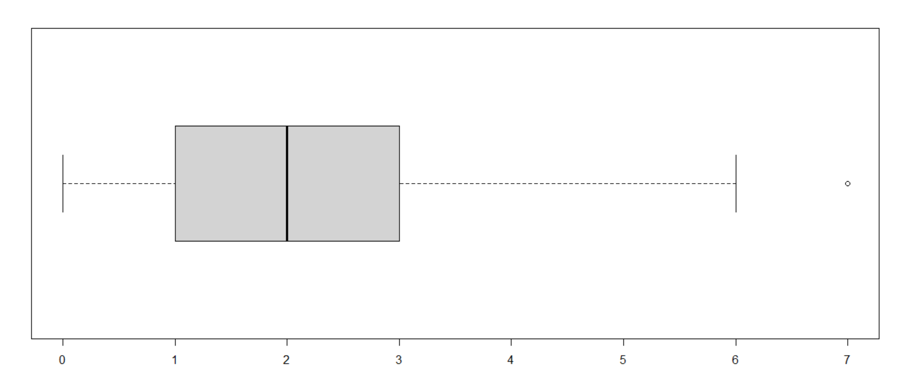
The sign of the Yule and Kendall coefficient – Graphically

Slide 7


Asymmetry Indicators – General Remarks
Remark 1 :
Remark 2 :

Slide 8
Exercise
The data below represents the age of visitors to a website:
Find the right proposal (among the four proposals below):
The coefficient of variation is less than 25%
The Pearson coefficient is positive
The mode is equal to 21.22 years
The average age is equal to 35.25 years
Age | Number of visitors
< 18 | 5
[18 ; 20[ | 15
[20 ; 30[ | 20
[30 ; 35[ | 30
[35 ; 50[ | 23
≥ 50 | 7

Slide 9
Exercise
The data below represents the age of visitors to a website:
Find the right proposal (among the four proposals below):
The coefficient of variation is less than 25%
The Pearson coefficient is positive
The mode is equal to 21.22 years
The average age is equal to 35.25 years
Age | Number of visitors
< 18 | 5
[18 ; 20[ | 15
[20 ; 30[ | 20
[30 ; 35[ | 30
[35 ; 50[ | 23
≥ 50 | 7

Slide 10
Exercise
The data below represents the age of visitors to a website:
Find the right proposal (among the four proposals below):
The first quartile is equal to 31,233
The median is equal to 29,431
The third quartile is equal to 36.28
The Yule and Kendall coefficient is negative
Age | Number of visitors
< 18 | 5
[18 ; 20[ | 15
[20 ; 30[ | 20
[30 ; 35[ | 30
[35 ; 50[ | 23
≥ 50 | 7

Slide 11
Exercise
The data below represents the age of visitors to a website:
Find the right proposal (among the four proposals below):
The first quartile is equal to 31,233
The median is equal to 29,431
The third quartile is equal to 36.28
The Yule and Kendall coefficient is negative
Age | Number of visitors
< 18 | 5
[18 ; 20[ | 15
[20 ; 30[ | 20
[30 ; 35[ | 30
[35 ; 50[ | 23
≥ 50 | 7

Slide 12
Exercise
The data below represents the number of products purchased during the visit of 100 visitors to a shopping center:
Find the right proposal (among the four proposals below):
The mean is equal to 2
The Pearson coefficient is negative
The standard deviation is equal to 1.470238
The coefficient of variation is greater than 95%
Nb of products purchased | Number of visitors
0 | 20
1 | 35
2 | 24
4 | 16
5 | 5

Slide 13
Exercise
The data below represents the number of products purchased during the visit of 100 visitors to a shopping center:
Find the right proposal (among the four proposals below):
The mean is equal to 2
The Pearson coefficient is negative
The standard deviation is equal to 1.470238
The coefficient of variation is greater than 95%
Nb of products purchased | Number of visitors
0 | 20
1 | 35
2 | 24
4 | 16
5 | 5

Slide 14
Exercise
The data below represents the number of products purchased during the visit of 100 visitors to a shopping center:
Find the right proposal (among the four proposals below):
The first quartile is equal to 0
The median is equal to 2
The Yule and Kendall coefficient is positive
The interquartile range is equal to 2
Nb of products purchased | Number of visitors
0 | 20
1 | 35
2 | 24
4 | 16
5 | 5

Slide 15
Exercise
The data below represents the number of products purchased during the visit of 100 visitors to a shopping center:
Find the right proposal (among the four proposals below):
The first quartile is equal to 0
The median is equal to 2
The Yule and Kendall coefficient is positive
The interquartile range is equal to 2
Nb of products purchased | Number of visitors
0 | 20
1 | 35
2 | 24
4 | 16
5 | 5

